Slide 1
LA GESTION FINANCIÈRE PERSONNELLE
Maîtriser vos finances, c'est maîtriser votre vie

Slide 2
Définition de la gestion financière personnelle
La gestion financière personnelle est le processus qui consiste à planifier, organiser et contrôler ses finances personnelles ou familiales afin d'atteindre des objectifs financiers spécifiques. Cela inclut l'élaboration d'un budget, la gestion des revenus et des dépenses, l'épargne, l'investissement, la gestion des dettes et la planification de la retraite.

Slide 3

L'impact psychologique de la gestion financière
L'argent influence directement notre bien-être mental. Une gestion financière désorganisée peut provoquer du stress, de l'anxiété et un
À l’inverse, une bonne gestion financière apporte une sensation de contrôle et de tranquillité. Savoir équilibrer ses revenus et ses dépenses, épargner
sentiment d'insécurité face aux dettes et aux imprévus. Cette pression constante peut affecter la concentration, le sommeil et même les relations personnelles.
pour l'avenir et éviter les dettes excessives permet de vivre plus sereinement. La stabilité financière renforce la confiance en soi et réduit les préoccupations du quotidien.

Slide 4

Mes croyances sur l’argent : forces et limites
"الفلوس وسخ الدنيا" :Cette vision peut engendrer un rejet inconscient de la réussite financière, freinant les opportunités de croissance personnelle et professionnelle.
"Je ne mérite pas d’être riche" :Une croyance limitante qui peut saboter les efforts financiers, empêchant de viser des objectifs ambitieux.
"L’argent est rare et difficile à obtenir" :Penser que l’argent est inaccessible peut créer un état d’esprit de pénurie, bloquant la prise d’initiatives pour améliorer ses finances.

Slide 5

Mes croyances sur l’argent : forces et limites
ولَا تَنسَ نَصِيبَكَ مِنَ الدُّنْيَا ۖ💡: Cette croyance encourage une gestion proactive des finances, favorisant l’épargne et l’investissement pour atteindre ses objectifs dans cette vie.
L’argent se mérite par le travail et la discipline 💪:
Elle pousse à l’effort, à l’éducation financière et au développement de compétences pour améliorer sa situation économique.
L’argent peut être un moyen d’aider les autres ❤️:
Voir l’argent comme un moyen de contribuer au bien-être des proches ou à des causes sociales renforce des valeurs d’entraide et de générosité.

Slide 6
BUSINESS COST ANALYSIS
43%
EARTH
Earth is the only planet known to harbor life
VENUS
24%
NEPTUNE
Neptune is the eighth planet from the Sun
33%
MARS
Despite being red, Mars is actually a cold place

Slide 7
BUSINESS COST ANALYSIS
01
02
03
04
EARTH
MARS
JUPITER
SATURN
Earth is the planet with life
Mars is full of iron oxide dust
Jupiter is a huge gas giant
Saturn is the ringed planet

Slide 8
BUSINESS COST ANALYSIS
-12,000
START VALUE
+$20,000
-12,000
+$39,000
INCREASE
RETURNS
NET SALES
Mercury is very small
Venus is very hot
Mars is very cold

Slide 9
BUSINESS COST ANALYSIS
1ST QUARTER
50%
75%
25%
Earth is the only planet known to harbor life
2ND QUARTER
Despite being red, Mars is a cold place
3RD QUARTER
Mercury is the smallest planet of them all

Slide 10
BUSINESS COST ANALYSIS
01
04
05
Mercury is the closest planet to the Sun
Earth is the third planet from the Sun
Jupiter was named after a Roman god
02
03
06
Venus is the second planet from the Sun
Mars is full of iron oxide dust
Saturn was named after a Roman god

Slide 11
BUSINESS COST ANALYSIS
MARS
SATURN
Mars is full of iron oxide dust, giving the planet its reddish cast
Saturn is the second-largest planet in the Solar System
MERCURY
EARTH
Mercury is the closest planet to the Sun and the smallest of them all
Earth is the third planet from the Sun and has life

Slide 12
BUSINESS COST ANALYSIS
MON | TUE | WED | THU | FRI | SAT | SUN
01 | 02 | 03 | 04 | 05 | 06 | 07
08 | 09 | 10 | 11 | 12 | 13 | 14
15 | 16 | 17 | 18 | 19 | 20 | 21
22 | 23 | 24 | 25 | 26 | 27 | 28
29 | 30 | 31
DEVALUATION
INCREASE SALES
INDIRECT SALES

Slide 13
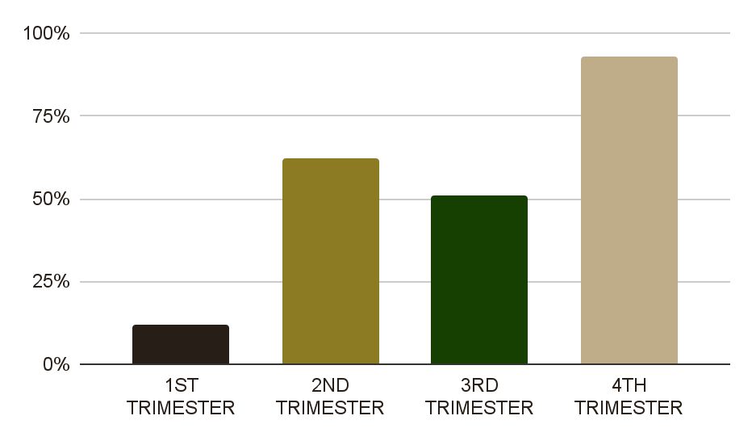
BUSINESS COST ANALYSIS
1ST TRIMESTER
Mercury is very small
2ND TRIMESTER
Venus is a hot planet
3RD TRIMESTER
Jupiter is a gas giant
4TH TRIMESTER
Follow the link in the graph to modify its data and then paste the new one here. For more info, click here
Saturn is the ringed planet

Slide 14
BUSINESS COST ANALYSIS
21%
Neptune is the farthest planet from the Sun
47%
Venus is the second planet from the Sun
13%
Earth is the third planet from the Sun and has life
19%
Saturn has a high number of moons, like Jupiter

Slide 15
BUSINESS COST ANALYSIS
NEPTUNE
Neptune is the eighth planet from the Sun
SATURN
Saturn is a gas giant and has several rings
JUPITER
Jupiter doesn’t have a solid surface
MERCURY
Mercury is the smallest planet of them all

Slide 16
BUSINESS COST ANALYSIS
BUSINESS EXPENSES
Mercury is a small planet | $25,000
Venus has a toxic atmosphere | $12,000
Mars is full of iron oxide dust | $11,000
FINANCING
Jupiter is a gas giant | $7,500
Saturn was named after a Roman god | $1,236
TOTAL | $56736

Slide 17
BUSINESS COST ANALYSIS
BALANCE
MERCURY
EARTH
JUPITER
Mercury is the closest planet to the Sun
Earth is the third planet from the Sun
Jupiter was named after a Roman god
32%
28%
40%

Slide 18
BUSINESS COST ANALYSIS
MERCURY
01
04
MARS
Mercury is the smallest planet of them all
Despite being red, Mars is actually a cold place
JUPITER
02
03
EARTH
Jupiter is the biggest planet in the Solar System
Earth is the only planet known to harbor life

Slide 19
BUSINESS COST ANALYSIS
JUPITER
Jupiter is a gas giant and the biggest planet in the Solar System
73%
VENUS
It’s the second-brightest natural object in the night sky after the Moon
MARS
Mars is full of iron oxide dust, giving the planet its reddish cast

Slide 20
BUSINESS COST ANALYSIS
INCOME |  | COMMENTS
Mercury is a small planet | $5,120 | Jupiter is the biggest planet in the Solar System Despite being red, Mars is actually a cold place
Venus has a toxic atmosphere | $32,320
Earth is the planet with life | $7,100
EXPENSES |  | COMMENTS
Jupiter is a gas giant | $13,500 | Saturn has a high number of moons, like Jupiter Neptune is the farthest planet from the Sun
Saturn was named after a Roman god | $250
Mars is full of iron oxide dust | $4,790

Slide 21
BUSINESS COST ANALYSIS
VENUS
Venus is the second planet from the Sun
MARS
JUPITER
Despite being red, Mars is actually a cold place
Jupiter is the biggest planet in the Solar System
EARTH
NEPTUNE
Earth is the only planet known to harbor life
Neptune is the eighth planet from the Sun

Slide 22
BUSINESS COST ANALYSIS
50%
75%
25%
NEPTUNE
SATURN
MARS
Neptune is the eighth planet from the Sun
Saturn has a high number of moons, like Jupiter
Despite being red, Mars is actually a cold place

Slide 23
BUSINESS COST ANALYSIS
01
03
02
04
MARS
MERCURY
Despite being red, Mars is actually a cold place
Mercury is the smallest planet of them all
NEPTUNE
SATURN
Neptune is the farthest planet from the Sun
Saturn has a high number of moons, like Jupiter

Slide 24
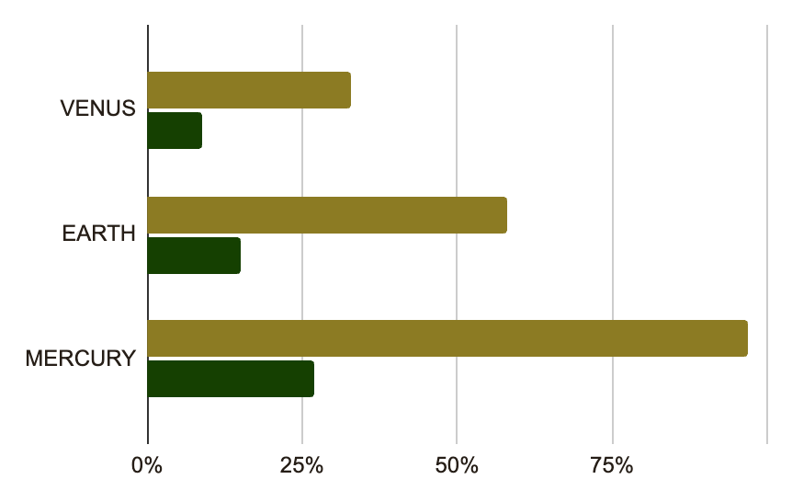
BUSINESS COST ANALYSIS
BUDGET #1
Jupiter is a gas giant and the biggest planet in the Solar System
BUDGET #2
Despite being red, Mars is actually a cold place. It’s full of iron oxide dust
Follow the link in the graph to modify its data and then paste the new one here. For more info, click here

Slide 25
BUSINESS COST ANALYSIS
20XX
20XX
Venus has a toxic atmosphere
Earth is the planet with life
Mars is full of iron oxide dust
Mercury is a small planet
Jupiter is a huge gas giant
Neptune is far away from us
Ceres is located in the main asteroid belt
Saturn is the ringed planet

Slide 26
BUSINESS COST ANALYSIS
01 | 02 | 03 | 04 | 05
MARS | VENUS | EARTH | JUPITER | SATURN
$5,920 | $11,230 | $7,500 | $4,230 | $15,256
Despite being red, Mars is actually a cold place | Jupiter is the biggest planet in the Solar System | Saturn has a high number of moons, like Jupiter | Neptune is the farthest planet from the Sun | Mercury is the smallest planet of them all

Slide 27
BUSINESS COST ANALYSIS
Despite being red, Mars is actually a cold place
Earth is the third planet from the Sun and has life
Jupiter is the biggest planet in the Solar System
01
02
03
04
05
Venus is the second planet from the Sun
Saturn has a high number of moons, like Jupiter

Slide 28
BUSINESS COST ANALYSIS
ACTIVITIES
COST
Saturn has a high number of moons, like Jupiter
Neptune is the farthest planet from the Sun
MERCURY
EARTH
JUPITER
MARS
Mercury is the closest planet to the Sun
Earth is the third planet from the Sun
Jupiter was named after a Roman god
Despite being red, Mars is very cold

Slide 29
BUSINESS COST ANALYSIS
79%
Earth is the only planet known to harbor life
Neptune is the eighth planet from the Sun
8%
Mercury is the smallest planet of them all
Despite being red, Mars is actually a cold place
13%
Jupiter is the biggest planet in the Solar System
Saturn has a high number of moons, like Jupiter

Slide 30
BUSINESS COST ANALYSIS
MERCURY
VENUS
Mercury is very small
Venus is very hot
SATURN
EARTH
ANALYSIS
Saturn is a gas giant
We all live on Earth
JUPITER
MARS
Jupiter is a gas giant
Mars is very cold

Slide 31
BUSINESS COST ANALYSIS
33% | EARTH | Earth is the planet with life $17,420
9% | MARS | Mars was named after a god $1,500
57% | NEPTUNE | Neptune is far away from Earth $4,320
21% | SATURN | Saturn is the ringed planet $91,500

Slide 32
BUSINESS COST ANALYSIS
JUPITER
SATURN
MARS
Jupiter is a gas giant
Saturn has rings
Mars is very cold
EARTH
VENUS
MERCURY
We all live on Earth
Venus is very hot
Mercury is small

Slide 33
BUSINESS COST ANALYSIS
43%
29%
43%
MERCURY
VENUS
EARTH
Mercury is very small
Mercury is very small
Mercury is very small
Mercury is very small
Mercury is very small
Mercury is very small
Mercury is very small
Mercury is very small
Venus is a hot planet
Venus is a hot planet
Venus is a hot planet
Venus is a hot planet
Venus is a hot planet
Venus is a hot planet
Venus is a hot planet
Venus is a hot planet
We all live on Earth
We all live on Earth
We all live on Earth
We all live on Earth
We all live on Earth
We all live on Earth
We all live on Earth
We all live on Earth

Slide 34
Instructions for use
If you have a free account, in order to use this template, you must credit Slidesgo in your final presentation. Please refer to the next slide to read the instructions for premium users.
As a Free user, you are allowed to:
- Modify this template.
- Use it for both personal and commercial projects.
You are not allowed to:
- Sublicense, sell or rent any of Slidesgo Content (or a modified version of Slidesgo Content).
- Distribute Slidesgo Content unless it has been expressly authorized by Slidesgo.
- Include Slidesgo Content in an online or offline database or file.
- Offer Slidesgo templates (or modified versions of Slidesgo templates) for download.
- Acquire the copyright of Slidesgo Content.
For more information about editing slides, please read our FAQs or visit our blog:
https://slidesgo.com/faqs and https://slidesgo.com/slidesgo-school

Slide 35
Instructions for use (premium users)
As a Premium user, you can use this template without attributing Slidesgo.
You are allowed to:
Modify this template.
Use it for both personal and commercial purposes.
Share this template in an editable format with people who are not part of your team.
You are not allowed to:
Sublicense, sell or rent this Slidesgo Template (or a modified version of this Slidesgo Template).
Distribute this Slidesgo Template (or a modified version of this Slidesgo Template) or include it in a database or in any other product or service that offers downloadable images, icons or presentations that may be subject to distribution or resale.
Use any of the elements that are part of this Slidesgo Template in an isolated and separated way from this Template.
Register any of the elements that are part of this template as a trademark or logo, or register it as a work in an intellectual property registry or similar.
For more information about editing slides, please read our FAQs or visit our blog:
https://slidesgo.com/faqs and https://slidesgo.com/slidesgo-school

Slide 36
Infographics
You can add and edit some infographics to your presentation to present your data in a visual way.
Choose your favourite infographic and insert it in your presentation using Ctrl C + Ctrl V or Cmd C + Cmd V in Mac.
Select one of the parts and ungroup it by right-clicking and choosing “Ungroup”.
Change the color by clicking on the paint bucket.
Then resize the element by clicking and dragging one of the square-shaped points of its bounding box (the cursor should look like a double-headed arrow). Remember to hold Shift while dragging to keep the proportions.
Group the elements again by selecting them, right-clicking and choosing “Group”.
Repeat the steps above with the other parts and when you’re done editing, copy the end result and paste it into your presentation.
Remember to choose the “Keep source formatting” option so that it keeps the design. For more info, please visit our blog.

